Slide 1
D205 Performance Assessment
By Matthew Heino

Slide 2


Research Question
The question that was asked using SQL
What were the average response ratings for the eight-questions grouped by the state?

Slide 3
How was the question answered?
Answered using Postgres and SQL
Software used was PGAdmin4
Required the creation of a table using the add-on file
Code to accomplish this is shown in the following slides

Slide 4
Table Creation
To create the table the following code was used:
DROP TABLE IF EXISTS public.surveys_csv;
CREATE TABLE IF NOT EXISTS public.surveys_csv
(
patient_id text COLLATE pg_catalog."default" NOT NULL,
item_1 integer,
item_2 integer,
item_3 integer,
item_4 integer,
item_5 integer,
item_6 integer,
item_7 integer,
item_8 integer,
CONSTRAINT surveys_csv_pkey PRIMARY KEY (patient_id)
)
TABLESPACE pg_default;
ALTER TABLE IF EXISTS public.surveys_csv
OWNER to postgres;

Slide 5

Loading Data Into Table
Code to load the table:
copy public.surveys_csv (patient_id, item_1, item_2, item_3, item_4, item_5, item_6, item_7, item_8) FROM 'C:/LabFiles/msurvey.csv' DELIMITER ',' CSV HEADER;

Slide 6
Executing The Research Query
Code for research:
SELECT
loc.state,
ROUND(AVG(surv.item_1), 2) AS ave_item_1,
ROUND(AVG(surv.item_2), 2) AS ave_item_2,
ROUND(AVG(surv.item_3),2) AS ave_item_3,
ROUND(AVG(surv.item_4),2) AS ave_item_4,
ROUND(AVG(surv.item_5),2) AS ave_item_5,
ROUND(AVG(surv.item_6),2) AS ave_item_6,
ROUND(AVG(surv.item_7),2) AS ave_item_7,
ROUND(AVG(surv.item_8),2) AS ave_item_8
FROM
patient AS pat
INNER JOIN location AS loc
ON loc.location_id = pat.location_id
INNER JOIN surveys_csv as surv
ON surv.patient_id = pat.patient_id
GROUP BY loc.state
ORDER BY loc.state DESC;

Slide 7
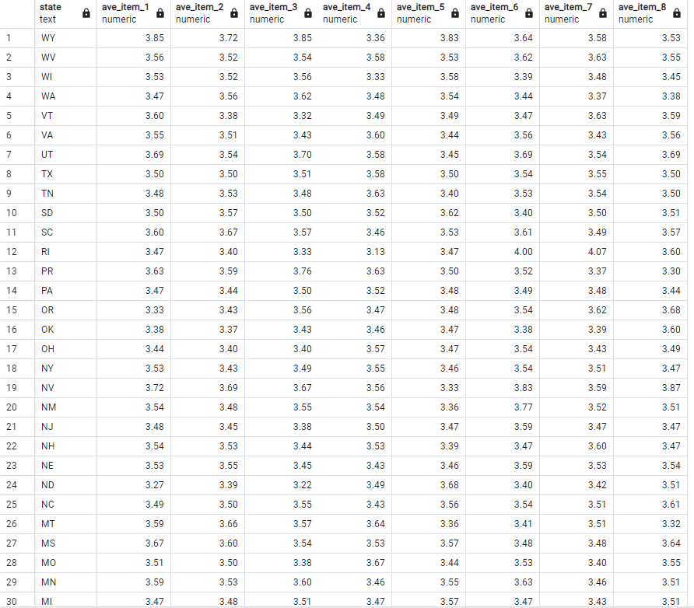
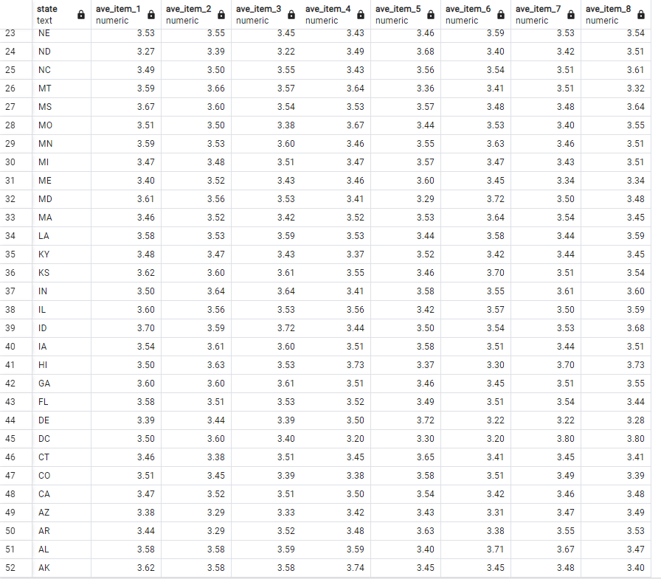
Results Of The Query

Slide 8
Copy Results to CSV File
Code to direct the results to a CSV file
COPY(
SELECT
loc.state,
ROUND(AVG(surv.item_1), 2) AS ave_item_1,
ROUND(AVG(surv.item_2), 2) AS ave_item_2,
ROUND(AVG(surv.item_3),2) AS ave_item_3,
ROUND(AVG(surv.item_4),2) AS ave_item_4,
ROUND(AVG(surv.item_5),2) AS ave_item_5,
ROUND(AVG(surv.item_6),2) AS ave_item_6,
ROUND(AVG(surv.item_7),2) AS ave_item_7,
ROUND(AVG(surv.item_8),2) AS ave_item_8
FROM
patient AS pat
INNER JOIN location AS loc
ON loc.location_id = pat.location_id
INNER JOIN surveys_csv as surv
ON surv.patient_id = pat.patient_id
GROUP BY loc.state
ORDER BY loc.state DESC
)
TO 'C:/LabFiles/results.csv'
DELIMITER ',' CSV HEADER;

